Slide 1
Chapter 4:Digital Transmission

Slide 2
Revision

Slide 3
What is the theoretical capacity of a channel in each of the following cases?
Bandwidth: 1 MHz SNRdB = 20

Slide 4

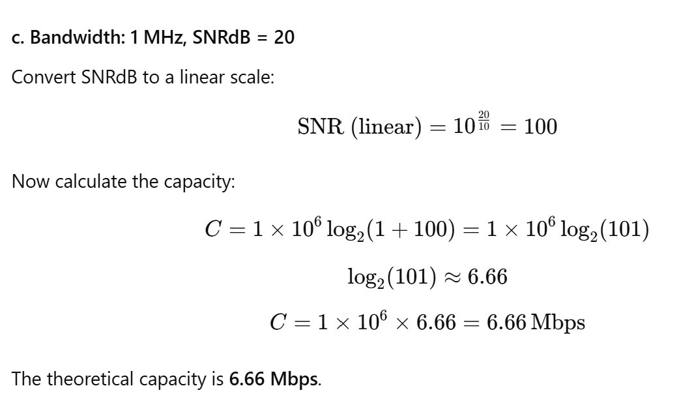


Slide 5
What is the total delay (latency) for a frame of size 5 million bits that is being sent on a link with 10 routers each having a queuing time of 2 μs and a processing time of 1 μs. The length of the link is 2000 Km. The speed of light inside the link is 2 × 108 m/s. The link has a bandwidth of 5 Mbps.
Which component of the total delay is dominant?
Which one is negligible?

Slide 7
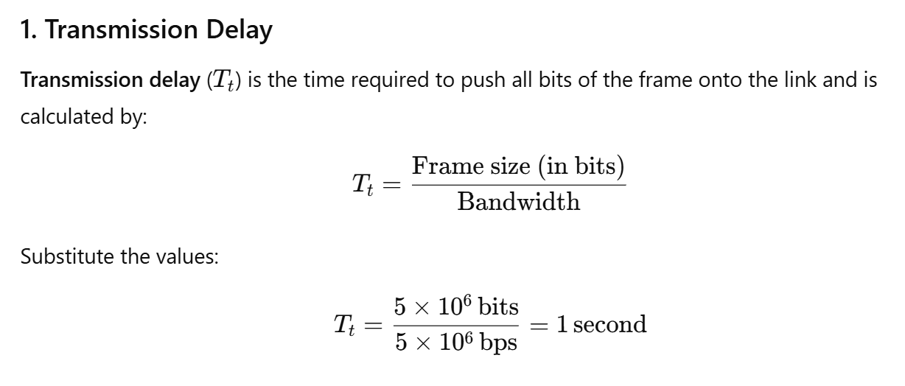

Slide 8
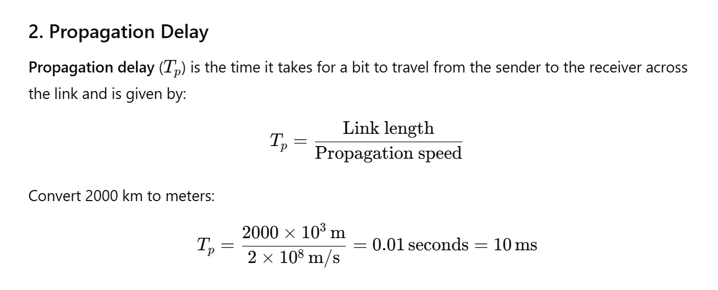

Slide 9
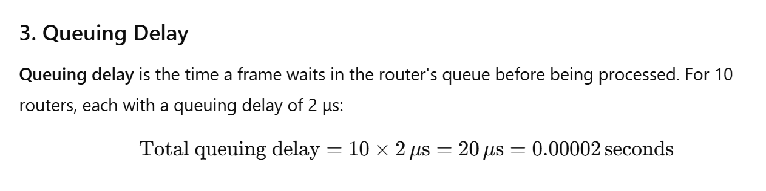

Slide 10
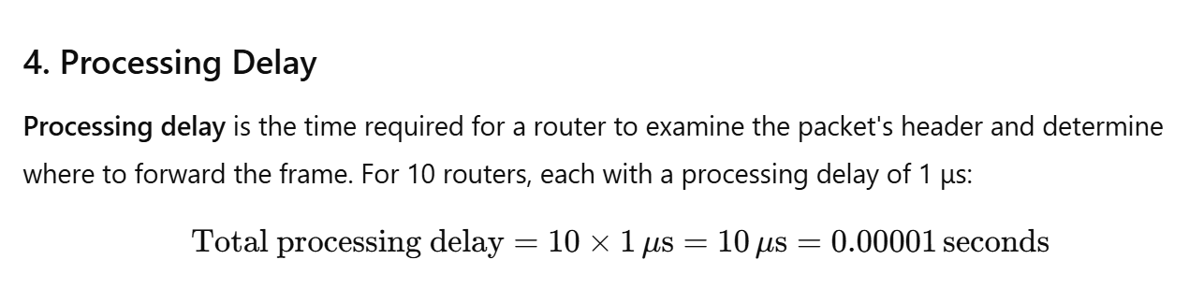

Slide 11
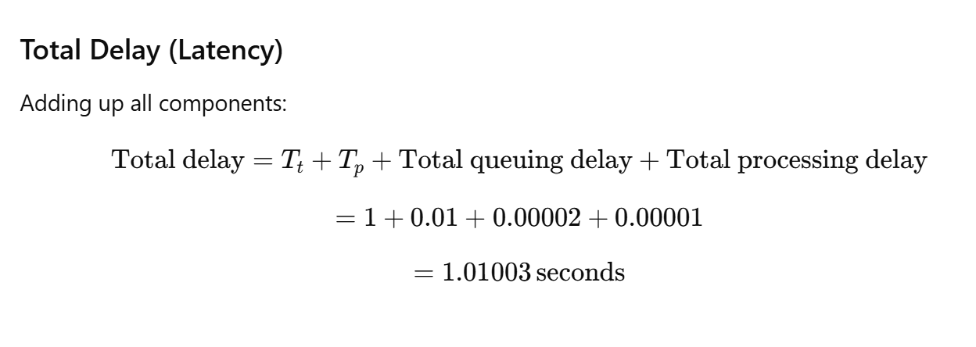

Slide 12
Agenda
Line Coding
Line Coding Schemes
Block Coding
Scrambling

Slide 13
DIGITAL-TO-DIGITAL CONVERSION
In this section, we see how we can represent digital data by using digital signals.
The conversion involves three techniques:
  Line coding,
  Block coding,
  Scrambling.
Line coding is always needed; block coding and scrambling may or may not be needed.

Slide 14
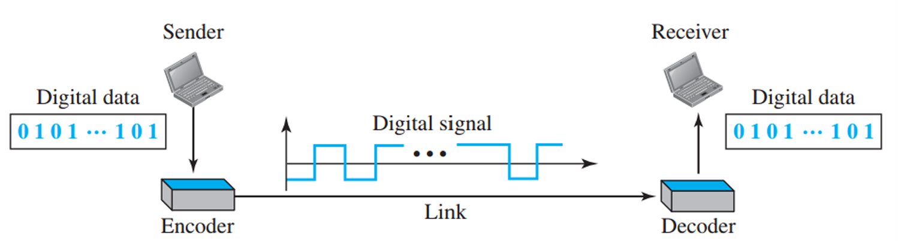
Line Coding
Line coding converts digital data to digital signals.
Digital data can be in the form of text, numbers, images, audio, or video.
Data is stored in computer memory as sequences of bits.
At the sender, digital data is encoded into a digital signal.
At the receiver, the digital data is recreated by decoding the digital signal.

Slide 15
Line Coding: Characteristics
Signal Element Versus Data Element
Data Rate Versus Signal Rate
Baseline Wandering
DC component
Self-synchronization

Slide 16
Signal Element Versus Data Element
A data element is the smallest entity that can represent a piece of information: this is the bit.
A signal element is the shortest unit (timewise) of a digital signal.
In other words, data elements are what we need to send; signal elements are what we can send.
Data elements are being carried; signal elements are the carriers.

Slide 17
Example
We define a ratio r which is the number of data elements carried by each signal element.
Suppose each data element is a person who needs to be carried from one place to another.
We can think of a signal element as a vehicle that can carry people.
When r = 1, it means each person is driving a vehicle.
When r > 1, it means more than one person is travelling in a vehicle (a carpool, for example).
We can also have the case where one person is driving a car and a trailer (r = 1/2).

Slide 18
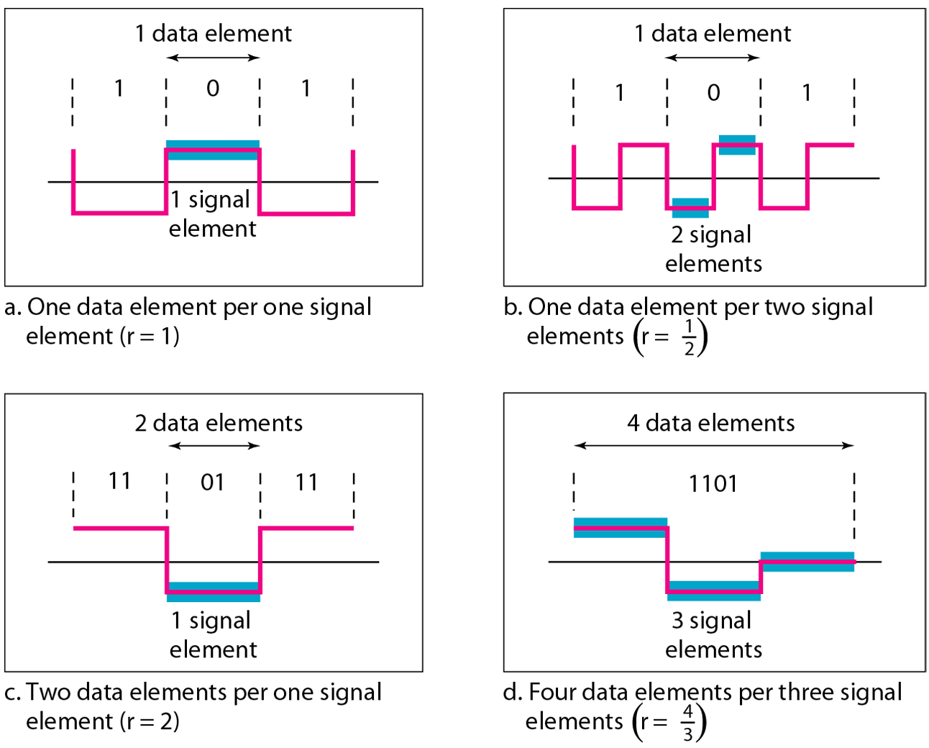
Signal Element Versus Data Element

Slide 19
Data Rate Versus Signal Rate
The data rate
  defines the number of data elements (bits) sent in 1s.
  The unit is bits per second (bps).
  The data rate is sometimes called the bit rate;
The signal rate
  is the number of signal elements sent in 1s.
  The unit is the baud.
  the signal rate is sometimes called the pulse rate, the modulation rate, or the baud rate.

Slide 20
Data Rate Versus Signal Rate
One goal in data communications is to increase the data rate while decreasing the signal rate.
Increasing the data rate increases the speed of transmission;
Decreasing the signal rate decreases the bandwidth requirement.
In our vehicle-people analogy, we need to carry more people in fewer vehicles to prevent traffic jams.
We have a limited bandwidth in our transportation system.

Slide 21
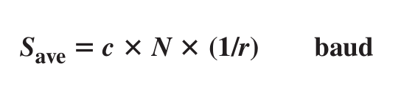
Data Rate Versus Signal Rate
We can formulate the relationship between data rate and signal rate as
where N is the data rate (bps); c is the case factor, which varies for each case; S is the number of signal elements per second; and r is the previously defined factor.

Slide 22

Example
A signal is carrying data in which one data element is encoded as one signal element (r = 1). If the bit rate is 100 kbps, what is the average value of the baud rate if c is between 0 and 1?
Solution:
We assume that the average value of c is 1/2. The baud rate is then

Slide 23
Baseline Wandering
In decoding a digital signal, the receiver calculates a running average of the received signal power.
This average is called the baseline.
The incoming signal power is evaluated against this baseline to determine the value of the data element.
A long string of 0s or 1s can cause a drift in the baseline (baseline wandering) and make it difficult for the receiver to decode correctly.
A good line coding scheme needs to prevent baseline wandering.

Slide 24
DC component
When the voltage level in a digital signal remains constant for long periods of time, there is an increase in the low frequencies of the signal.
These frequencies around zero, called DC (direct-current) components.
System can not pass low frequencies. For example, a telephone line cannot pass frequencies below 200 Hz.
This will require the removal of the dc component of a transmitted signal.

Slide 25
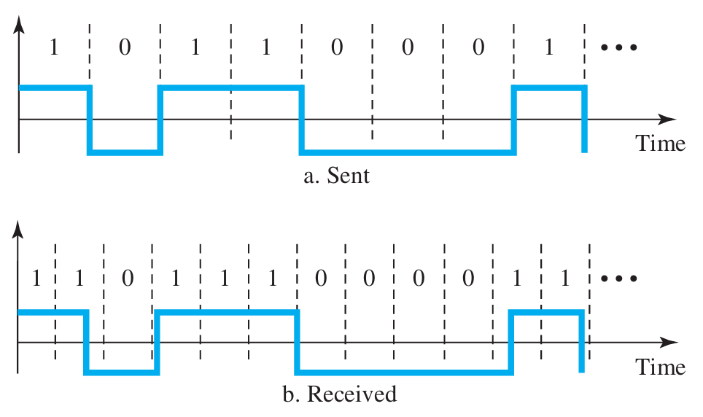
Self-synchronization
To correctly interpret the signals received from the sender, the receiver’s bit intervals must correspond exactly to the sender’s bit intervals.
If the receiver clock is faster or slower, the bit intervals are not matched and the receiver might misinterpret the signals.

Slide 26
Self-synchronization
Self-synchronizing digital signal includes timing information in the data being transmitted.
This can be achieved if there are transitions in the signal that alert the receiver to the beginning, middle, or end of the pulse.
If the receiver’s clock is out of synchronization, these points can reset the clock.

Slide 27
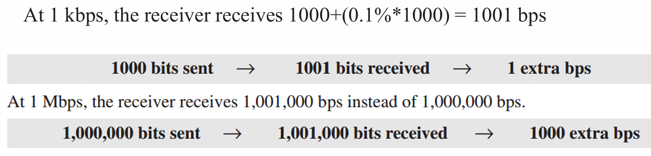
Example
In a digital transmission, the receiver clock is 0.1 percent faster than the sender clock.
How many extra bits per second does the receiver receive if the data rate is 1 kbps? How many if the data rate is 1 Mbps?
Solution:

Slide 28
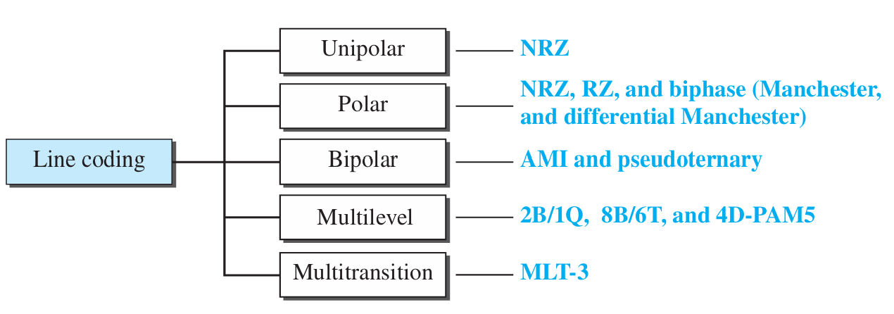
Line Coding Schemes
Notes:
M 18 38 H 13

Slide 29
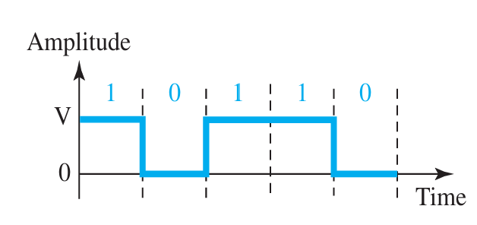
NRZ (Non-Return-to-Zero)
NRZ (Non-Return-to-Zero) Traditionally, a unipolar scheme was designed as a non-return-to-zero (NRZ) scheme in which the positive voltage defines bit 1 and the zero voltage defines bit 0.
It is called NRZ because the signal does not return to zero at the middle of the bit.

Slide 30
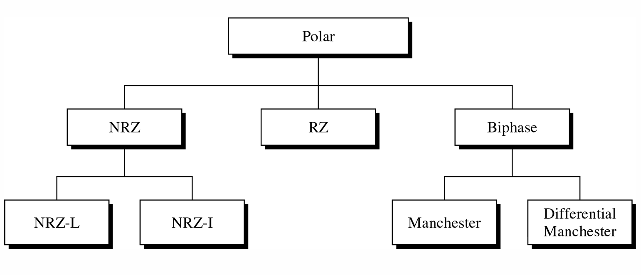
Polar Scheme
The voltages are on both sides of the time axis.
For example, the voltage level for 0 can be positive and the voltage level for 1 can be negative.

Slide 31
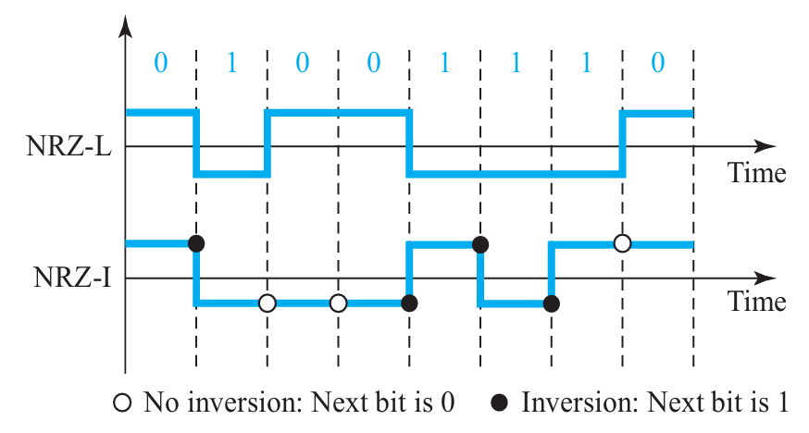
NRZ-L (NRZ-Level)
Level of the voltage determines the value of the bit.
In the second variation, NRZ-I (NRZ-Invert), the change or lack of change in the level of the voltage determines the value of the bit.
If there is no change, the bit is 0; if there is a change, the bit is 1.

Slide 32
Return-to-Zero (RZ)
The main problem with NRZ encoding occurs when the sender and receiver clocks are not synchronized.
The receiver does not know when one bit has ended and the next bit is starting.

Slide 33
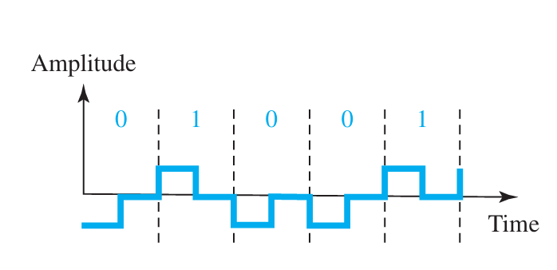
Return-to-Zero (RZ)
One solution is the return-to-zero (RZ) scheme, which uses three values: positive, negative, and zero.
In RZ, the signal changes not between bits but during the bit.

Slide 34
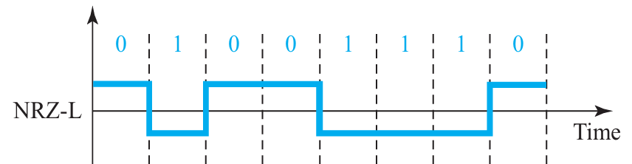
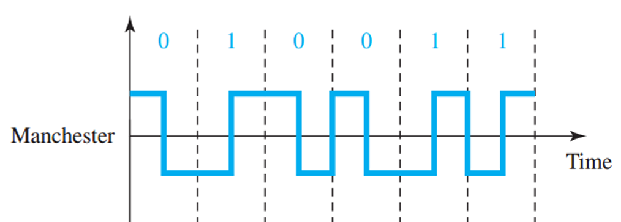
Biphase: Manchester
Manchester coding consists of combining the NRZ-L and RZ schemes.
Every symbol has a level transition in the middle: from high to low or low to high. Uses only two voltage levels.

Slide 35
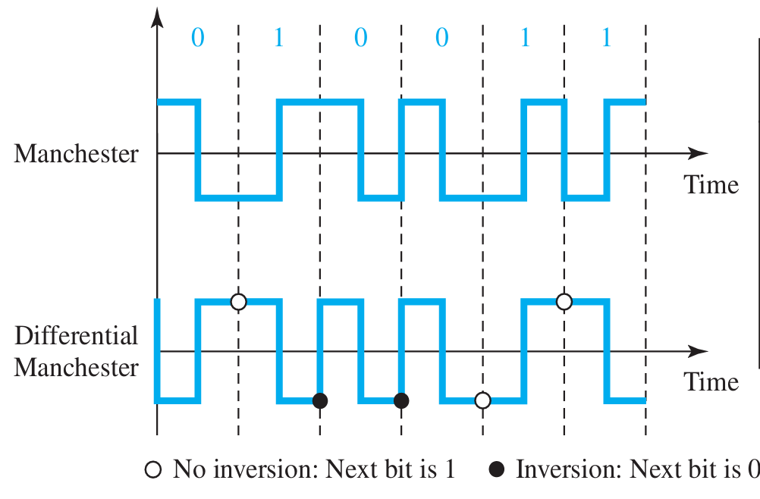
Differential Manchester
Combines the ideas of RZ and NRZ-I.
There is always a transition at the middle of the bit, but the bit values are determined at the beginning of the bit.
If the next bit is 0, there is a transition; if the next bit is 1, there is none.

Slide 36
Manchester and differential Manchester schemes
In Manchester and differential Manchester encoding, the transition at the middle of the bit is used for synchronization.
There is no DC component because each bit has a positive and negative voltage contribution.
The only drawback is the signal rate.
The signal rate for Manchester and differential Manchester is double that for NRZ.
The reason is that there is always one transition at the middle of the bit and maybe one transition at the end of each bit.

Slide 37
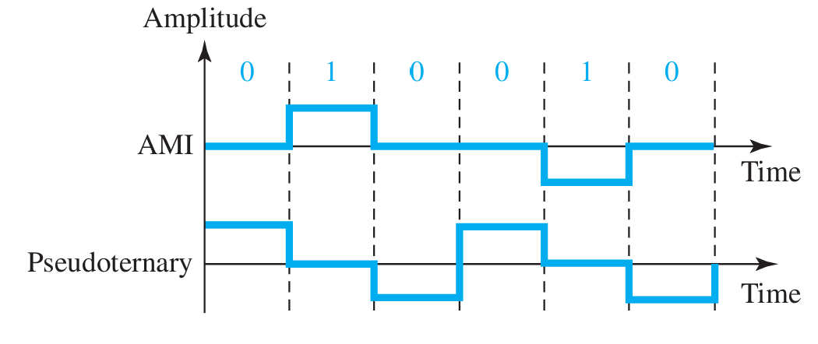
Bipolar Schemes
Bipolar encoding (sometimes called multilevel binary)
  Three voltage levels: positive, negative, and zero
  Two variations of bipolar encoding
AMI (alternate mark inversion)
  0: neutral zero voltage
  1: alternating positive and negative voltages

Slide 38
Bipolar Schemes
Pseudoternary
  1: neutral zero voltage
  0: alternating positive and negative voltages

Slide 39
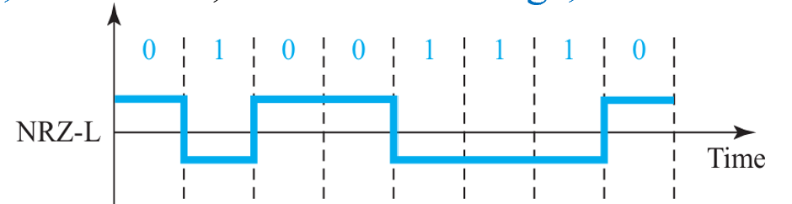
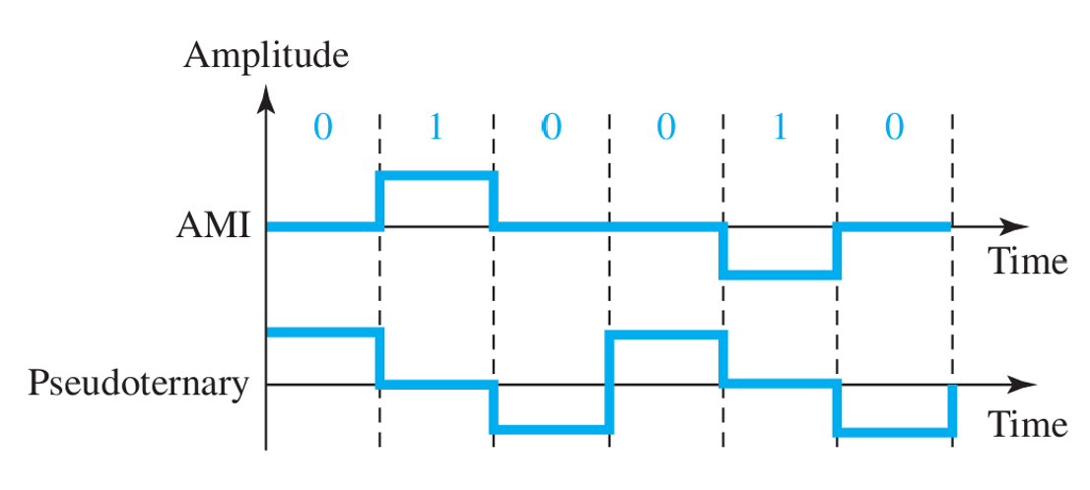
Bipolar Schemes
Has no DC component.
If we have a long sequence of 1s, the voltage level alternates between positive and negative; it is not constant. Therefore, there is no DC component.
For a long sequence of 0s, the voltage remains constant, but its amplitude is zero, which is the same as having no DC component. In other words, a sequence that creates a constant zero voltage does not have a DC component.

Slide 40
Exercises

Slide 41
True or False
The data rate and signal rate are the same in line coding.
In NRZ-L line coding, the signal level does not change during the bit interval.
Manchester encoding involves changing the voltage at the beginning of each bit.
AMI (Alternate Mark Inversion) uses only two voltage levels.

Slide 42
True or False
The data rate and signal rate are the same in line coding.
In NRZ-L line coding, the signal level does not change during the bit interval.
Manchester encoding involves changing the voltage at the beginning of each bit.
AMI (Alternate Mark Inversion) uses only two voltage levels.

Slide 43
Which line coding scheme involves changing voltage at the middle of each bit?
A) NRZ-L
B) Manchester
C) AMI
Notes:
Manchester

Slide 44
In Bipolar schemes, which of the following describes the AMI (Alternate Mark Inversion) method?
A) A single voltage level is used for "1" and zero voltage for "0"
B) Positive, zero, and negative voltage levels are used, with "1" represented by alternating polarities
C) Each bit interval has a transition to synchronize the signal
D) Voltage always returns to zero during each bit interval
Notes:
Answer: B) Positive, zero, and negative voltage levels are used, with "1" represented by alternating polarities

Slide 45
. Which of the following is NOT a characteristic of line coding?
A) Baseline wandering
B) Self-synchronization
C) Signal distortion
D) DC component
Notes:
Answer: C) Signal distortion

Slide 46
Which of the following issues can affect transmission in systems that cannot pass low frequencies?
A) Baseline wandering
B) DC component
C) Signal rate
D) Synchronization
Notes:
Answer: B) DC component

Slide 47
Task

Slide 48
Compare Unipolar, Polar, and Bipolar encoding in terms of
  Schema,
  Bandwidth,
  DC components,
  Synchronization.

Slide 49
Practical

Slide 50
Project Title: Digital Data Line Coding Simulator
Project Overview:
This Python project will simulate the encoding of binary data using various line coding schemes (e.g., NRZ, RZ, Manchester). The user will input a binary string, select a coding scheme, and the program will display the corresponding signal representation.

